Slide 1
Uncertainty-aware performance assessment of optical imaging modalities with invertible neural networks
2019/10/17
Out of Distribution Detection for Intra-operative Functional Imaging
Tim J. Adler^{1,2},
Leonardo Ayala¹, Lynton Ardizzone³, Hannes G. Kenngott⁴, Anant Vemuri¹,
Sebastian J. Wirkert¹, Beat P. Müller-Stich⁴, Carsten Rother³, Ullrich Köthe³, and
Lena Maier-Hein¹
¹Division of Computer Assisted Medical Interventions, German Cancer Research Center (DKFZ ) Heidelberg, Germany
2Faculty of Mathematics and Computer Science, Heidelberg University, Germany
3Visual Learning Lab, Heidelberg University, Germany
4Division of Minimally-invasive Surgery of the Department of General Surgery, Heidelberg University, Germany

Slide 2
Which organs are perfused?
No blood flow
Blood flow
Blood flow
No blood flow
Blood flow
Wirkert,…, Maier-Hein: “Physiological parameter estimation from multispectral images unleashed”, MICCAI 2017
Wirkert,…, Maier-Hein: “Robust near real-time estimation of physiological parameters…”, Int J Cars (IPCAI 2016) 2016
Wirkert,…, Maier-Hein: “Endoscopic Sheffield Index for unsupervised in vivo spectral band selection.”, MICCAI CARE workshop, 2014

Slide 3
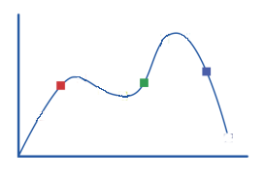
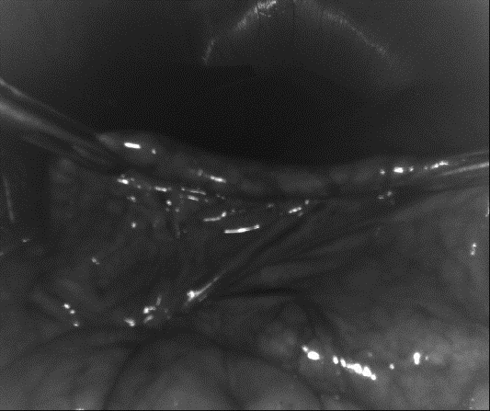
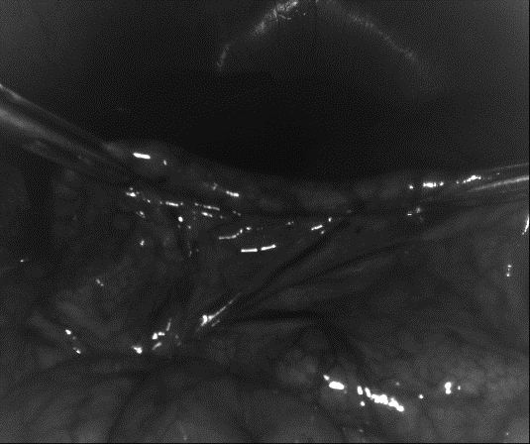
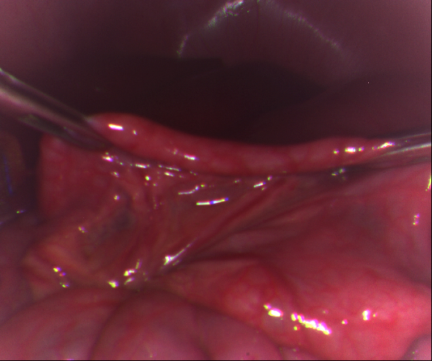
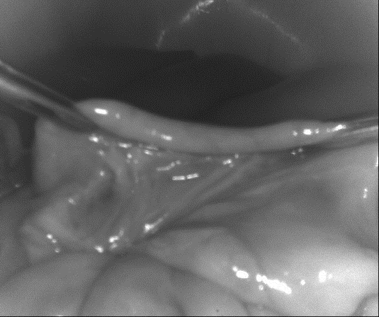
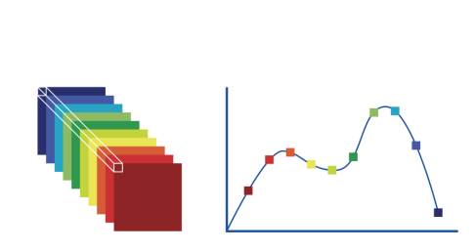
Multispectral imaging
Human eye/
RGB camera
Multispectral
camera

Slide 4
Multispectral imaging
Wirkert,…, Maier-Hein: “Physiological parameter estimation from multispectral images unleashed”, MICCAI 2017
Wirkert,…, Maier-Hein: “Robust near real-time estimation of physiological parameters…”, Int J Cars (IPCAI 2016) 2016
Wirkert,…, Maier-Hein: “Endoscopic Sheffield Index for unsupervised in vivo spectral band selection.”, MICCAI CARE workshop, 2014

Slide 5
Limitations of point estimates in inverse problems
Oxygenation
s0₂= 87%
Training
s0₂= 63%
x
y
p(x|y)
Application
Neural Network
s0₂ = ?
63%
87%
Adler et al.: “Uncertainty-aware performance assessment of optical cameras with Invertible Neural Networks”, IPCAI 2019

Slide 6
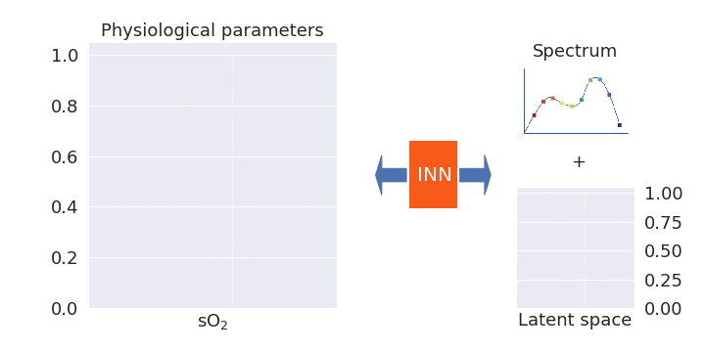
Invertible Neural Networks to recover a posterior probability distribution
Adler et al.: “Uncertainty-aware performance assessment of optical cameras with Invertible Neural Networks”, IPCAI 2019

Slide 7
Any open problems?
Training data
Test data
No performance guarantees on outliers
?

Slide 8
Multi stage workflow:
Out of distribution detection
Key requirement: Unsupervised

Slide 9
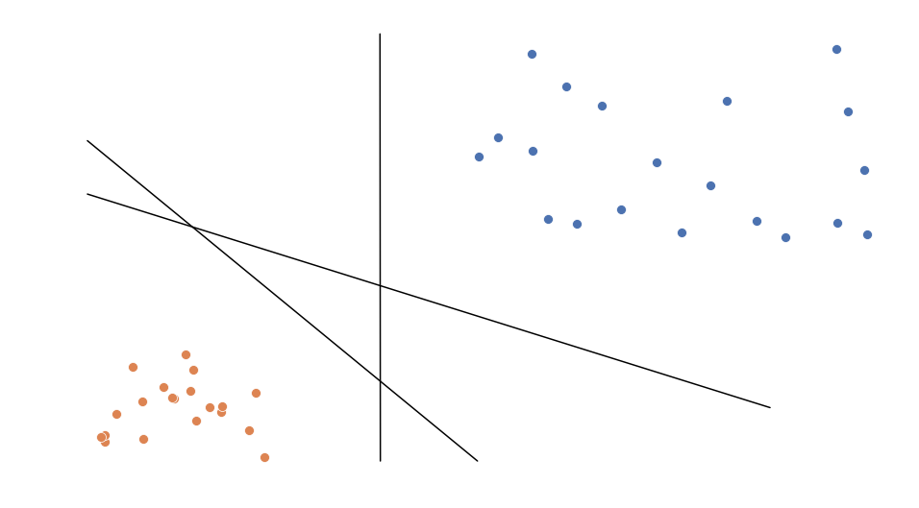
Ensemble approach to OoD
Linear classifiers
Variance in class prediction

Slide 10
Widely Applicabe Information Criterion
(WAIC)
Model for exact log-likelihood
Aggregation over trained parameters 𝛩
Watanabe, et al.: "Algebraic geometry and statistical learning theory". Cambride University Press, 2009
Choi, et al.: "Waic, But Why? Generative Ensembles for Robust Anomaly Detection", arXiv, 2018

Slide 11
WAIC example

Slide 12
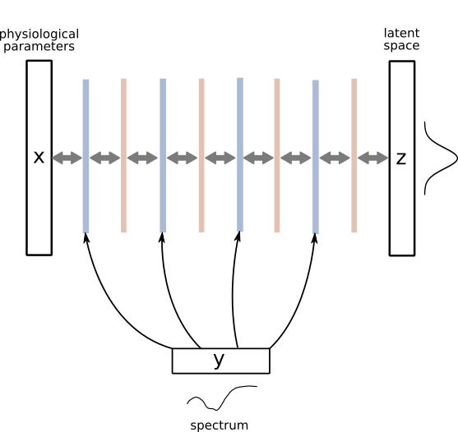
Invertible Neural Nets & WAIC
Spectra
Latent space
Training distribution
Normal distribution
Jacobi determinant efficiently computable
Change of variable formula accessible:
Normal distribution
Change of
variable

Slide 13
Experiments
Icon made by Freepik from www.flaticon.com

Slide 14
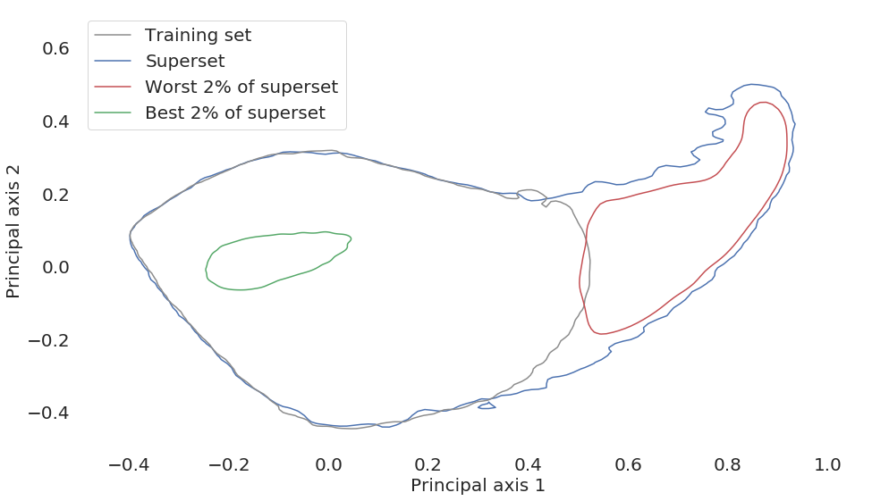
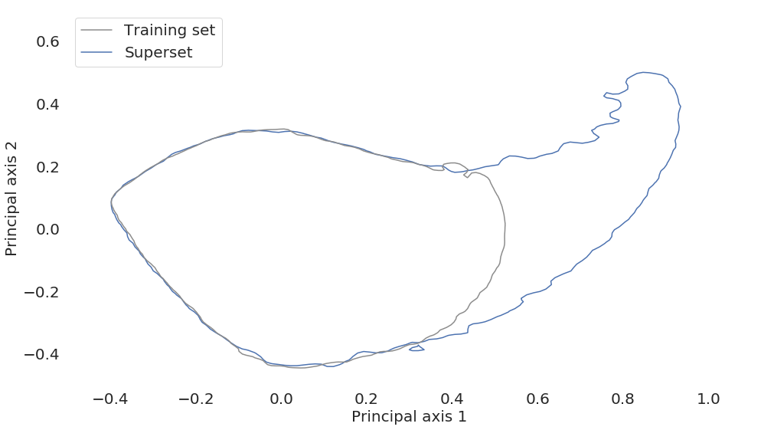
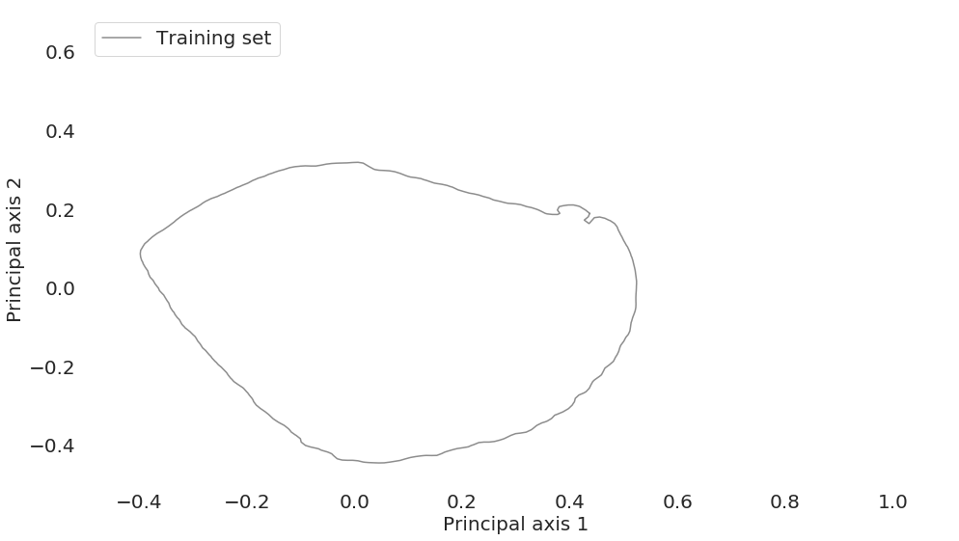
In silico validation
Simulation framework for organ spectra

Slide 15
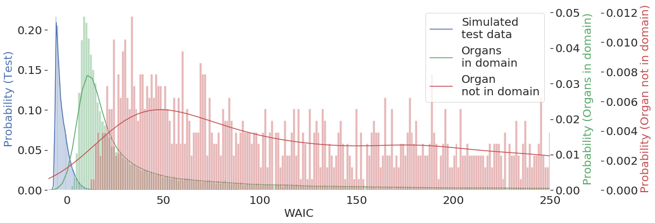
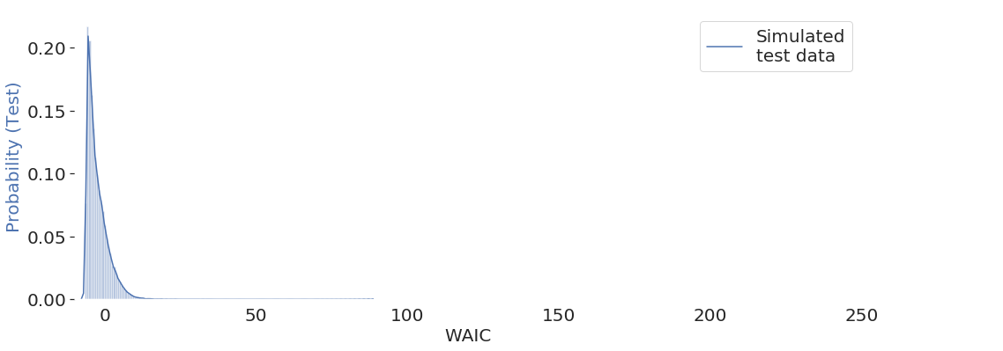
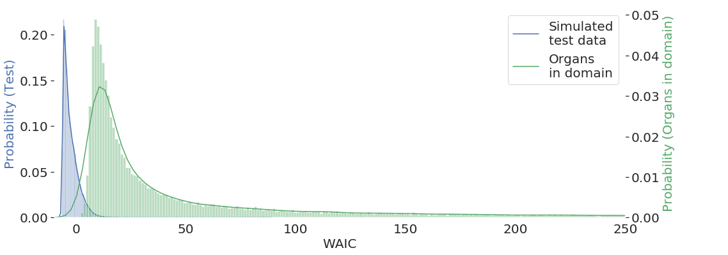
Domain gap: simulation & real data
Simulation framework for organ spectra
Includes: Hb, HbO₂, H₂O,...
Not includes: Bilirubin (Bile)
Train on simulated spectra
Evaluation on porcine organ spectra

Slide 16
Scene change detection with WAIC
Thank you for your attention!

Slide 17
Implementation details
Training set: 500.000 spectra
Test set: 50.000 spectra
In silico validation: training split 49% / 51%
Ensemble size: 5
Epochs: 120
Learning rate: 1.0e-3
Optimizer: Adam
Layers: 10 affine coupling blocks
3 layer fc subnets

Slide 18
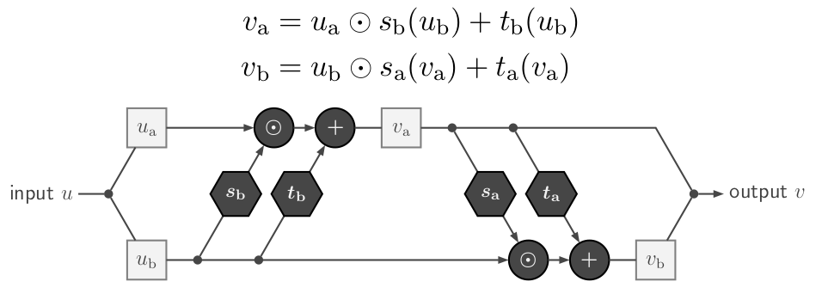
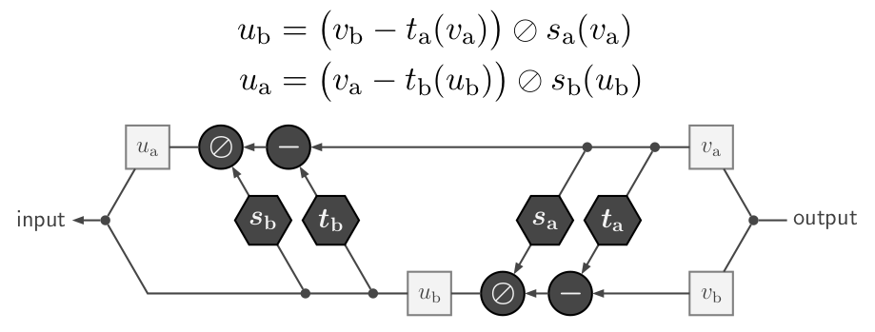
Coupling layers
With permission from Lynton Ardizzone

Slide 19
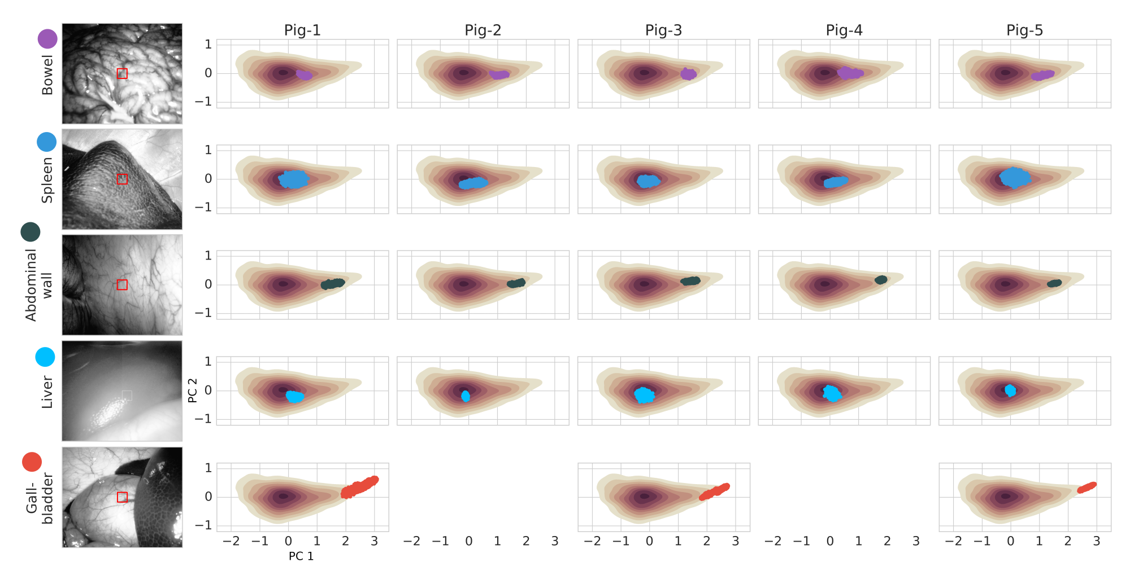
Porcine organ data

Slide 20
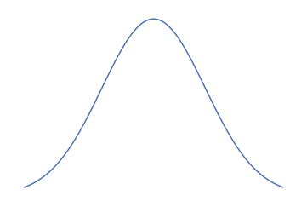
Comparison to cVAE
spectrum
spectrum
physiological
parameters
physiological
parameters
physiological
parameters
One net as decoder & encoder
Guaranteed invertibility
Synergy effects during training
No dimension reduction
Model size
Efficiently computable Jacobian
Change of variable formula
Exact log-probabilities
In principle Maximum-Likelihood training
After convergence: Similar capabilities
y
y
x
x
INN
x
INN
INN⁻¹
z
z
latent
space
latent
space
spectrum
physiological
parameters
physiological
parameters
y
x
Enc
Dec
x
z
latent
space

Slide 21
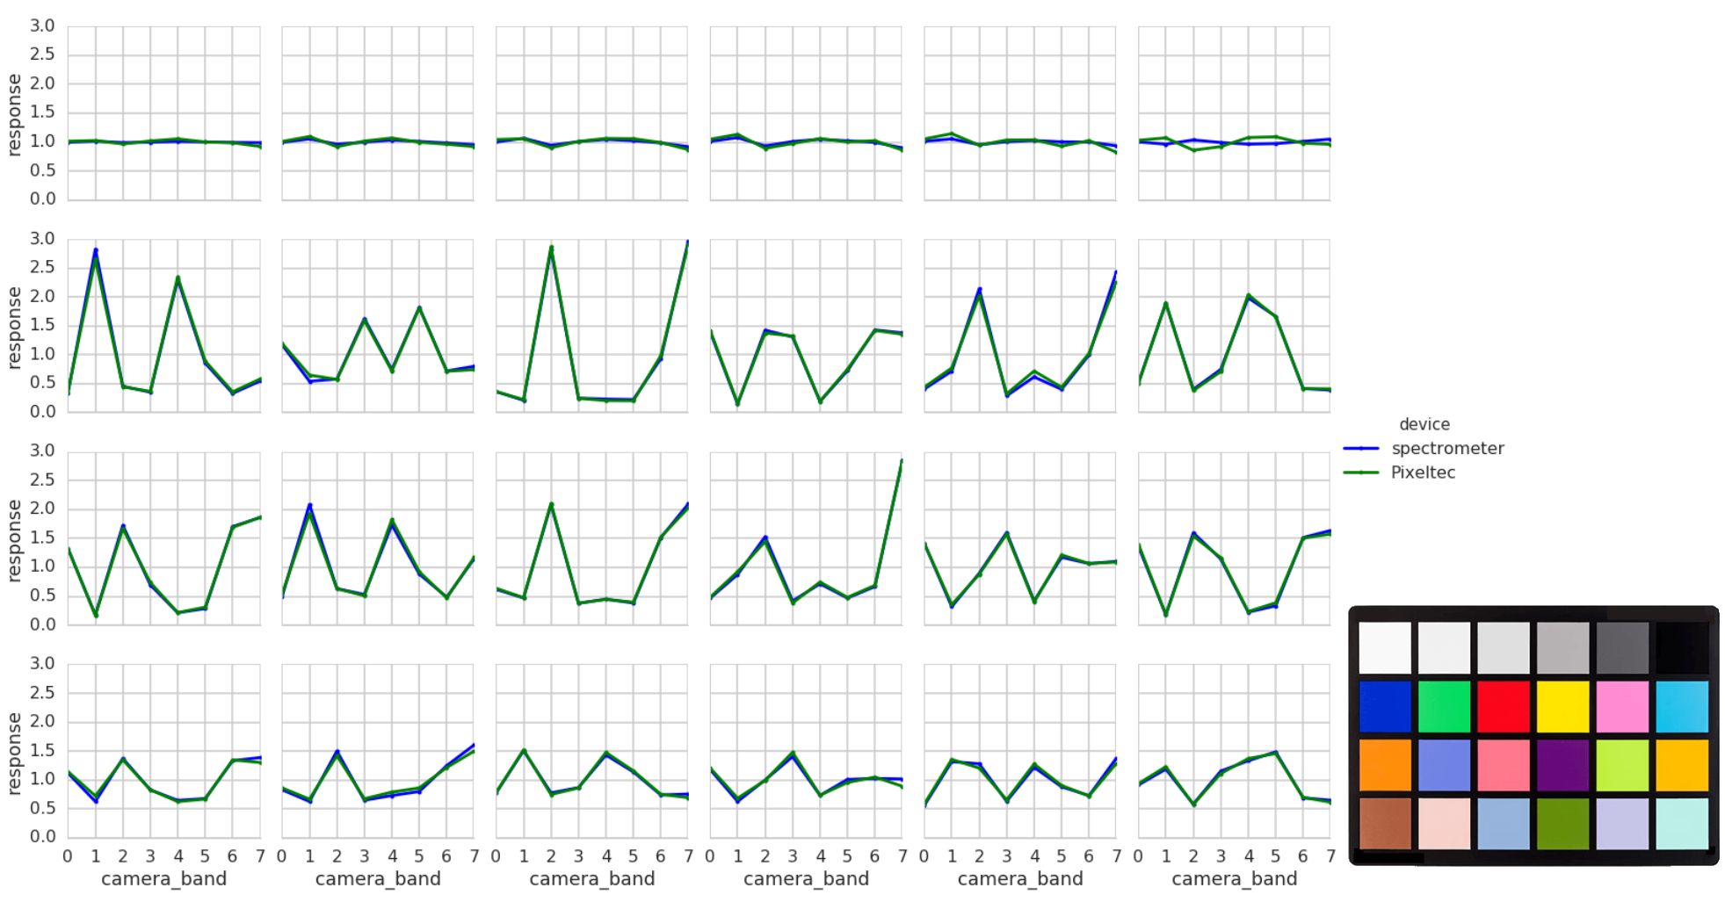
Filter response functions

Slide 22
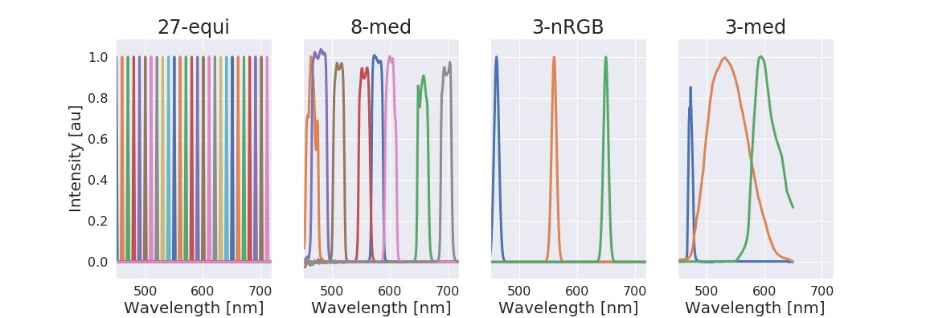
Monte Carlo simulation
~20,000 simulated spectra (split in train, validation & test)
Wavelengths 450 - 720nm (2nm steps)
3 layer tissue model
Variable thickness
0% ≤ sO₂ ≤ 100%
0% ≤ vHb ≤ 10%
Monte Carlo simulation with 10⁶ photons

Slide 23
Invertible Neural Network (INN) architecture
Design inherently invertible network:
Evaluation/Training bidirectional
No dimension reduction
2 types of losses
L₂ for regression
Maximum Mean Discrepancy for distributions
Jacobi determinant efficiently computable
Change of variable formula
Maximum-Likelihood training
permutation layer
coupling layer
Ardizzone,…, Maier-Hein,…: “Analyzing Inverse Problems with Invertible Neural Networks”, ICLR 2019

Slide 24
ML learning + cVAE = conditional INNs
INN
conditional INN
cINN trainable with maximum likelihood training only
No more zero padding

Slide 25
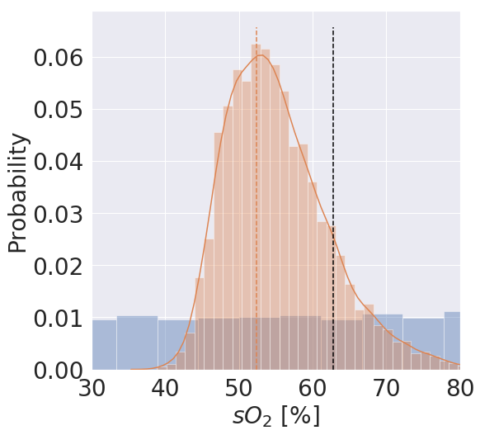
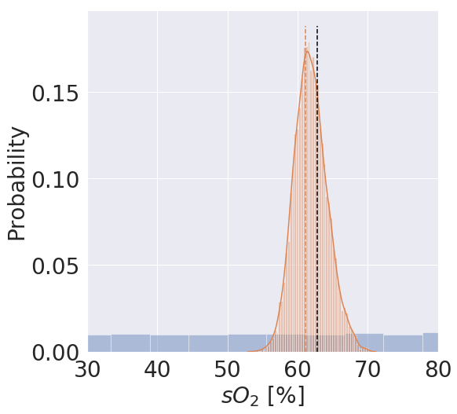
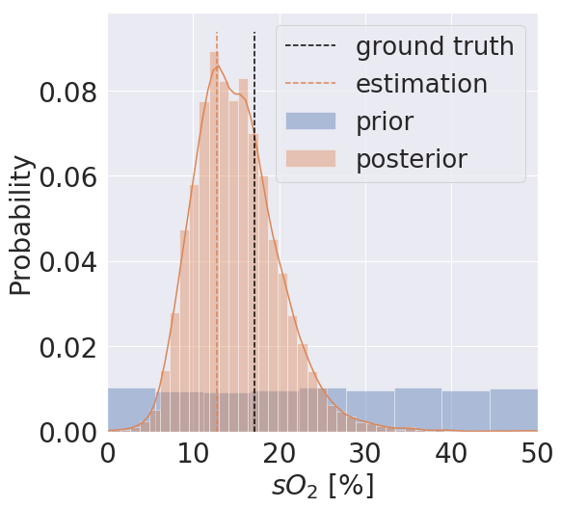
Posteriors
wide
narrow
bimodal

Slide 26
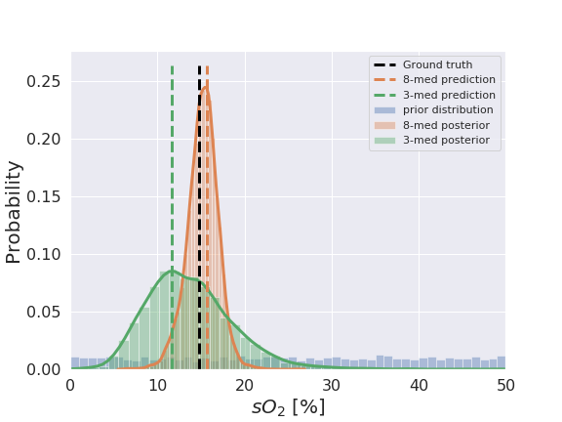
Application: Camera selection for multispectral imaging
Ardizzone,…, Maier-Hein,…: “Analyzing Inverse Problems with Invertible Neural Networks”, ICLR 2019

Slide 27
Challenges
Curse of dimensionality
No dimensionality reduction possible
4 loss terms
each with hyperparameter(s)
Calibration of posterior

Slide 28
Opportunities & Outlook
Zero padding / losses
New architecture: conditional INN
Ambiguity of inverse problem vs. data ambiguity
Ensembles of INNs as outlier detectors
Thank you very much for your attention
For a complementary view
join the 'Europe got talents' session

Slide 29
x₁
x₁
NN
NN
x
x
exp
x₂
*
+
x₂

Slide 30
5 slides
Focus:
More INNs pitchen
Not so much 'camera comparison'
Challenges
Size / dimensions
Number of loss terms
OoD
Opportunities
evtl robotics (broadly applicable)
Ending:
OoD pitchen
3 questions outlook for long talk
architectural details (+ cINNs)
Applications: OoD detection
Auf ERC talk verweisen
ERC Logo Anfang und Ende
Alle Autoren am Anfang
Fragen:
Abgrenzung andere Methoden

Slide 31
Recap
Training data
Camera adaption
INN architecture
Coupling blocks
Permutation layers
Invertibility
Comparison to other architectures
INN training
Loss terms
Results
Challenges
Many losses
Curse of dimension / zero padding
Opportunities
cINN
WAIC

